Slide 1

Presentation for the Bank Customer Churn Prediction
By
Young Jin Jang

Slide 2
Contents
Information of the data
Business Problem
Background of the data
KNN model vs Random Forest model
Final Decision of the model
Final Recommendation

Slide 3
Information of the Data
The task is to predict whether a bank customer will 'churn' or close their account. We can also call this data as Bank Customer Data for Predicting Customer Churn
This data has credit score, country, gender, age, tenure, balance, product number, credit card, active member, estimated salary, and churn features.
I found this dataset by Kaggle website.
(https://www.kaggle.com/datasets/gauravtopre/bank-customer-churn-dataset)
There has 12 columns and 10,000 different data

Slide 4
Business Problems
The Churn rate, sometimes known as attrition rate, is the rate at which customers stop doing business with a company over a given period.
The main point of the analyzing the data is that if there has a lot of Churn Customers, what the bank have to do for solving the problem against a lot of Churn Customers.
If there has a lot of Churn Customers in the bank, then that means the value of that bank is decreasing.
To solve the problem, we need to check how many Churn Customer presents in the bank first and then we need to think to analyze the results.

Slide 5
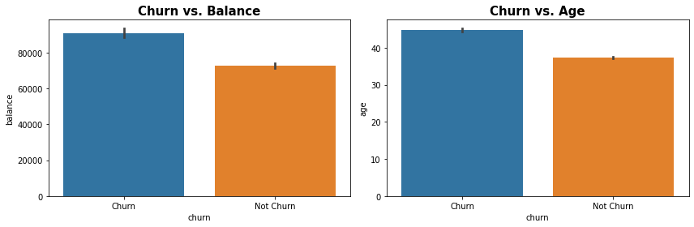
Background of The Data
The task is to predict whether a bank customer will 'churn' or close their account. I think there has strong correlation between the target and the columns of Balance and Age
For the Churn vs Balance plot, it tells that Customer Churn has more average balance than who does not Customer Churn. This might be affected to the bank if they close their accounts. Therefore, the bank need to find a way to hold those Customer Churn.
For the Churn vs Age plot, it tells that the average age of the Customer Chun is higher than the average age of the Customer Chun. I think some people close the account when they are approximately 40. Therefore, the bank need to focus on making new customers.

Slide 6
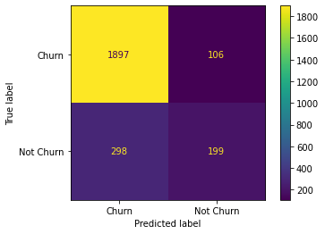
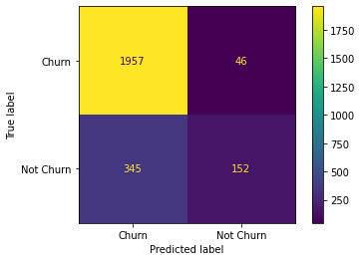
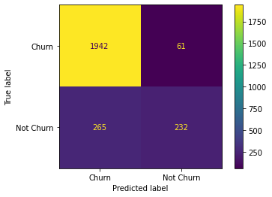
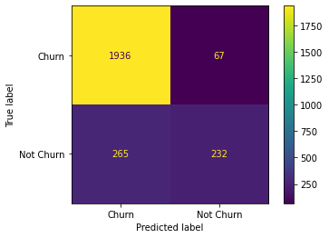
KNN model and KNN_gs model
Random Forest model and RF_gs model

Slide 7
KNN model with the GridSearchCV
2,500 accounts were tested for the Bank Customer Churn Prediction
The classifier of KNN model predicted 2,003 accounts to have tested positive and the rest 497 as negative.
However, 2302accounts tested positive and 198 tested negative.

Slide 8
I will chose the KNN_gs model because there has less errors when i compared with other confusion matrixs. Confusion matrix for the KNN_gs shows 46 errors in the total, but other confusion matrix shows more error than KNN_gs True Negative is better than True Positive at pridicting in the confusion matrix for the KNN_gs
Final Recommendation to the Bank
These are cases in which we predicted that there has a lot of Churn Customers.
I will recommend to find new customers as many as you can since there has a lot of Churn Customers in the bank.

Slide 9
Thank You
-THE END-

Slide 18
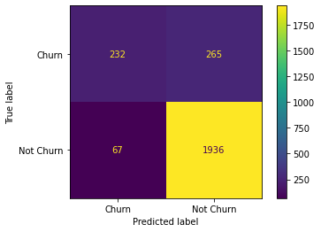
Random Forest with the GridSearchCV
2,500 accounts were tested for the Bank Customer Churn Prediction
The classifier of KNN model predicted 2,003 accounts to have tested positive and the rest 497 as negative.
However, 2,201 accounts tested positive and 299 tested negative.

Slide 19
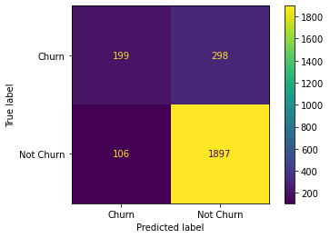
KNN model
2,500 accounts were tested for the Bank Customer Churn Prediction
The classifier of KNN model predicted 2,003 accounts to have tested positive and the rest 497 as negative.
However, 2,195 accounts tested positive and 305 tested negative.

Slide 20
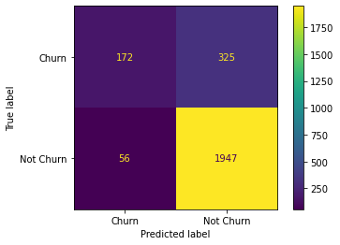
KNN model with the GridSearchCV
2,500 accounts were tested for the Bank Customer Churn Prediction
The classifier of KNN model predicted 2,003 accounts to have tested positive and the rest 497 as negative.
However, 2,272 accounts tested positive and 228 tested negative.

Slide 21

Random Forest
2,500 accounts were tested for the Bank Customer Churn Prediction
The classifier of KNN model predicted 2,003 accounts to have tested positive and the rest 497 as negative.
However, 2,197 accounts tested positive and 303 tested negative.

Slide 22
Final Recommendation
K cfvxΩ

Slide 23
Thank You
-THE END-

